Slide 1
Version Control System

Slide 2

Agenda
Why VCS ?
Type of VCS
Tooling landscape
Git
Git Workflow
Git branching & merging
Basic git commands
Hands on using Git

Slide 3
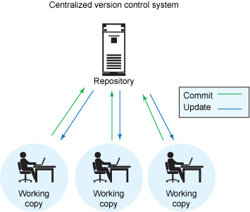
Why VCS
Individual
Backup methodology
Increments – know which version is live
Point in time marking aka. Tagging
Branching – release versions maintained & main development can continue
Team
Allow multiple developers (in remote locations) to work on same code base
Merge changes across same files – handle collisions
Answer who did what – blame / praise

Slide 4
Types of VCS
Centralized VCS:
Centralized version control systems (CVCS) focuses on synchronizing, tracking, and backing up files.
Distributed VCS:
Distributed version control systems (DVCS) focuses on sharing changes; every change has a guid or unique id.
Centralized Version Control System
Distributed Version Control System

Slide 5
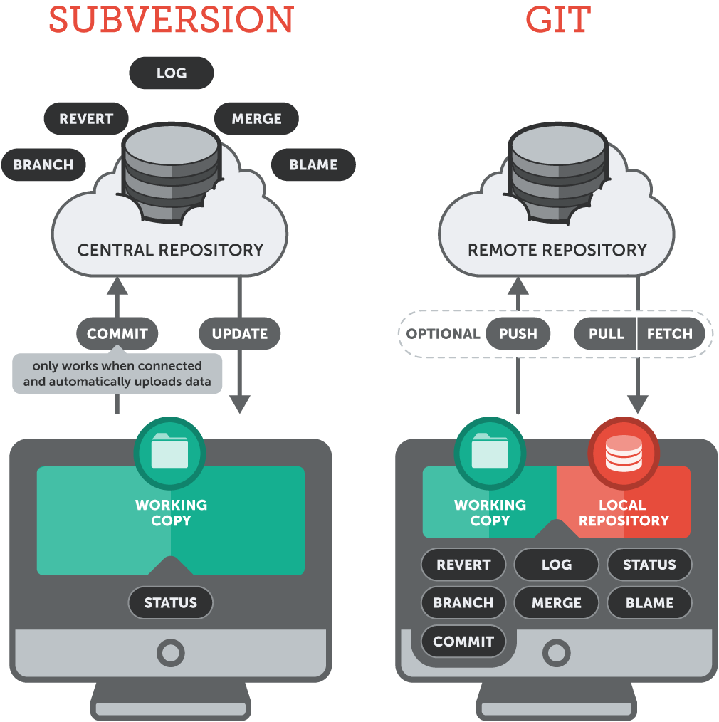
Centralized Vs Distributed VCS

Slide 6






Tooling Landscape

Slide 7
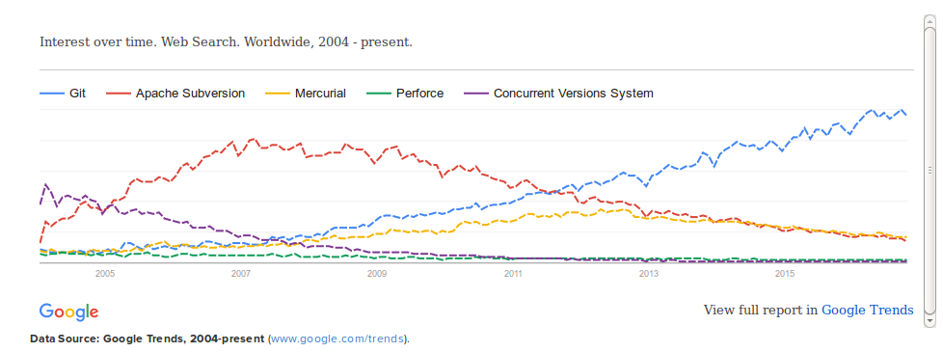
Notes:
https://rhodecode.com/insights/version-control-systems-2016

Slide 8
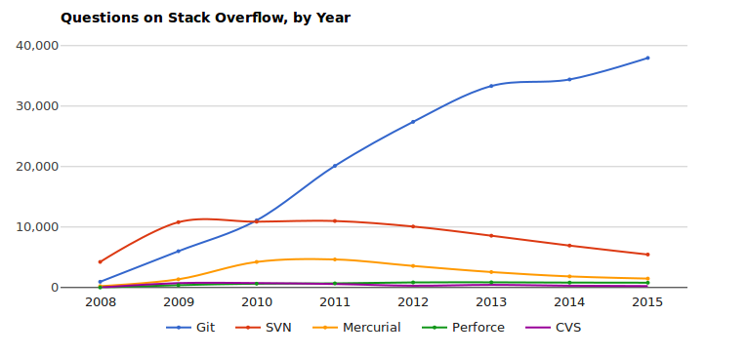

Slide 9

Git
Git is Open Source Distributed Version control System. It is a tool for keeping a history for the state of your source code. This also provides source code management.
Installation: Install it with very simple steps.
For Linux
$ apt-get install git
Other systems
https://www.git-scm.com/
Version
$ git --version

Slide 10
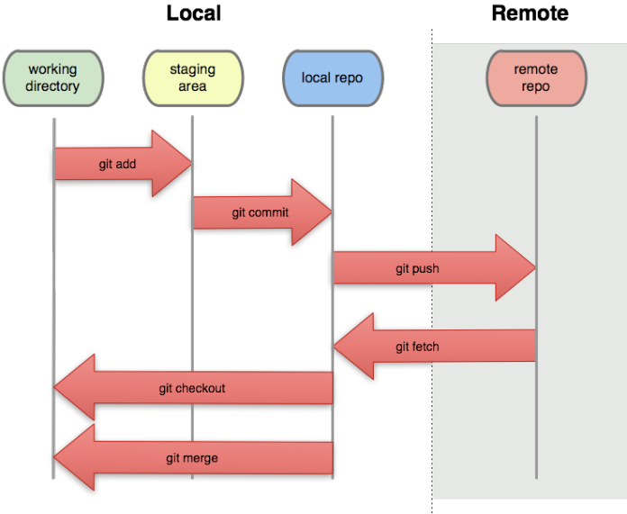
Git Workflow
Git workflow can be divided in two blocks.
Local:
Add local files to staging area
Commit your changes to local repo
Cut branch locally
Merge branches
Remote
Push your committed changes to remote repo.
Pull/Fetch changes from remote to local

Slide 11
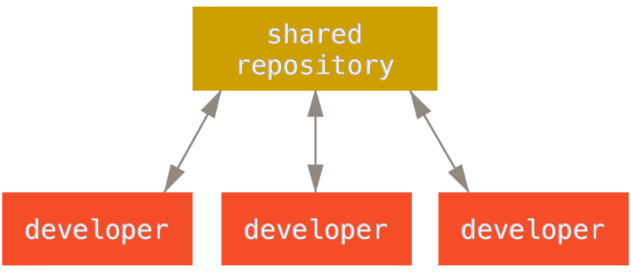
Distributed Workflows
Centralized Workflow

Slide 12
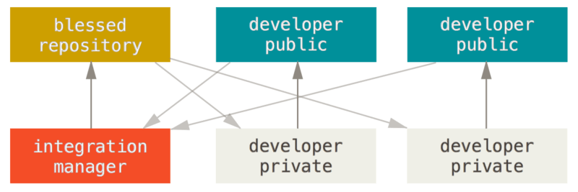
Distributed Workflows
Integration-Manager Workflow

Slide 13
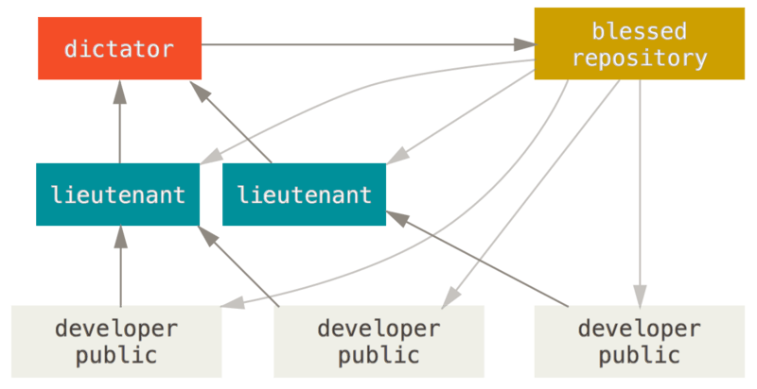
Distributed Workflows
Dictator and Lieutenants Workflow

Slide 14

Basic Git commands
Git init
Git clone
Git add
Git rm
Git commit
Git push
Git pull
Git branch
Git checkout

Slide 15
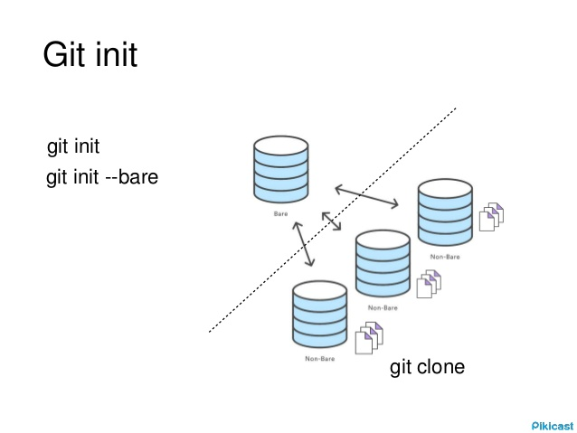
Git init: Create an empty Git repository or reinitialize an existing one.
Run git init
$ git init workbase
(This will create a workbase directory and initialized this with .git directory.)
Options
-q : --quiet :
Only print error and warning messages; all other output will be suppressed.
--bare :
Create a bare repository.

Slide 16
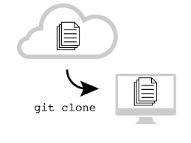
Git clone: Copies an existing Git repository.
Run git clone
$ git clone <repo>
(This will make a copy of remote directory into your local machine)
Options
-l : --local :
Repository to clone from is on a local machine.
-o <name> : --origin <name> :
Instead of using the remote name origin to keep track of the upstream repository, use <name>.

Slide 17
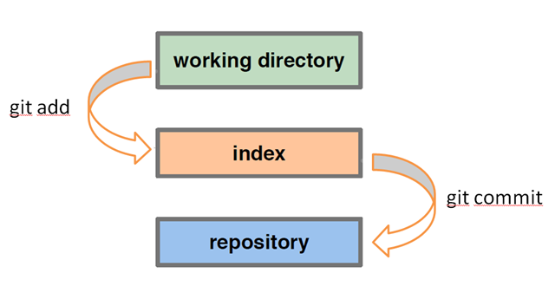
Git add: Add file contents to the index.
Run git add
$ git add <filename or wildcard>
(This will add your files to the index or staging area in git.)
Options
-n : --dry-run :
Don’t actually add the file(s), just show if they exist and/or will be ignored.
--no-all : --ignore-removal :
Add new files to index but ignore files that have been removed from the working tree.

Slide 18
Git rm: Remove file contents to the index.
Run git rm
$ git rm <filename or wildcard>
(This will remove your files from the index or staging area in git.)
Options
-n : --dry-run :
Don’t actually remove any file(s), just show if they exist and/or will be ignored.
-r :
Allow recursive removal when a leading directory name is given.
--cached
Use this option to unstage and remove paths only from the index. Working tree files, whether modified or not, will be left alone.
git rm

Slide 19
Git commit: Record changes to the repository.
Run git commit
$ git commit -m “<message>”
(This will remove your files from the index or staging area in git.)
Options
-a : --all :
Tell the command to automatically stage files that have been modified and deleted, but new files you have not told Git about are not affected.
-n : --dry-run :
Don’t actually commit any file(s), just show if they exist and/or will be ignored.
-C <commit> : --reuse-message=<commit> :
Take an existing commit object, and reuse the log message and the authorship information (including the timestamp) when creating the commit.

Slide 20
Git push: Update remote refs along with associated objects.
Run git push
$ git push <remote name> <branch>
(This will ship your files from the local repo to remote repo.)
$ git push origin HEAD:master
(This will ship your files from current local branch to the remote master branch.)
Options
-n : --dry-run :
Do everything except actually send the updates.
--delete :
All listed refs are deleted from the remote repository. This is the same as prefixing all refs with a colon.
Remote Repo
git push
git push
Local Repo
Local Repo

Slide 21
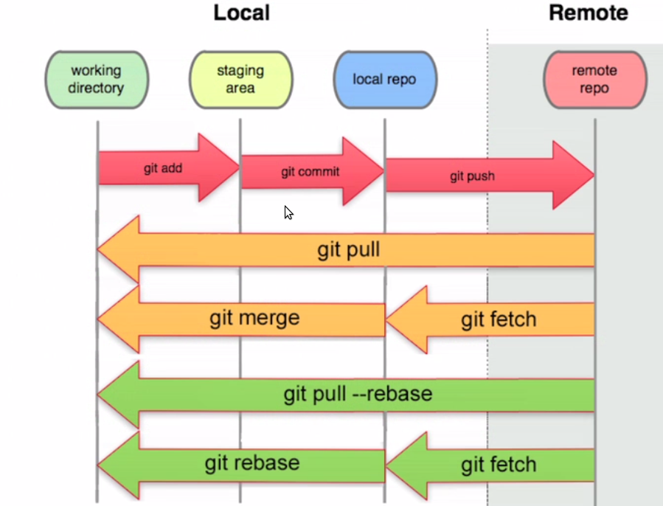
Git pull: Fetch from and integrate with another repository or a local branch.
Run git pull
$ git pull <remote name> <branch>
(This will ship all the changes from remote to local repo and merge too.)
Options
--commit :
Perform the merge and commit the result. This option can be used to override --no-commit.
--ff :
When the merge resolves as a fast-forward, only update the branch pointer, without creating a merge commit. This is the default behavior.

Slide 22
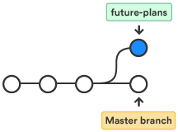
Git branch: List, create, or delete branches.
Run git branch
$ git branch <branch name>
(This will create a new branch into your local repository.)
$ git branch -a
(This will list all your branches i.e. local and remote. Also put an (*) before your current branch.)
Options
-d: --delete :
Delete a branch.
-m : --move :
Move/rename a branch and the corresponding reflog.

Slide 23
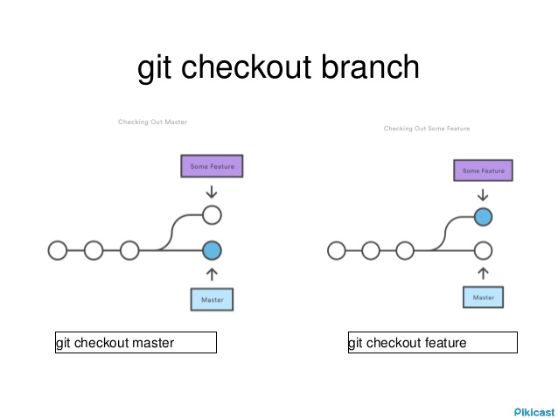
Git checkout: Switch branches or restore working tree files.
Run git checkout
$ git checkout <branch name>
(This will switch into a branch.)
$ git checkout -b <branch name>
(This will first create and then switch into that branch.)
Options
-f : --force :
When switching branches, proceed even if the index or the working tree differs from HEAD.
-B <new_branch>
Creates the branch <new_branch> and start it at <start_point>; if it already exists, then reset it to <start_point>.

Slide 24
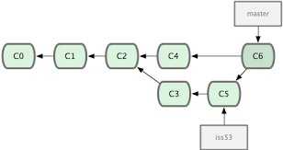
Git Branching & Merging
Use branches to work on multiple features in parallel
Test out new ideas, fix bugs
You should do most of your development work in a branch
There seems to be a lot of branching surrounding git. These folks probably were burned by some other VCS in the past that had poor branch support
Git has great branch support

Slide 25
Github: Features
Wiki: Every GitHub repository comes equipped with a section for hosting documentation, called a wiki. GitHub Wikis are a place in your repository where you can share long-form content about your project, such as how to use it, how it's been designed, manifestos on its core principles, and so on. Whereas a README is intended to quickly orient readers as to what your project can do, wikis can be used to provide additional documentation.
Fork: A fork is a copy of a repository. Forking a repository allows you to freely experiment with changes without affecting the original project.
Issues: These are a great way to keep track of tasks, enhancements, and bugs for your projects. They’re kind of like email—except they can be shared and discussed with the rest of your team. Most software projects have a bug tracker of some kind. GitHub’s tracker is called Issues, and has its own section in every repository.

Slide 26
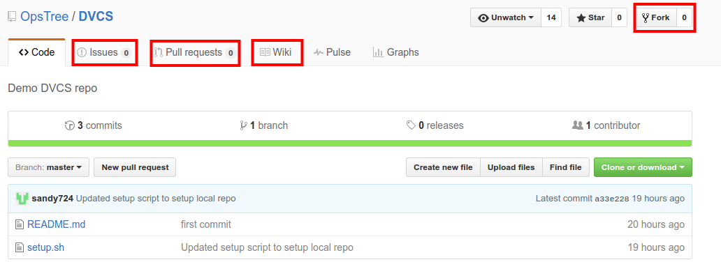
Github: Features

Slide 27
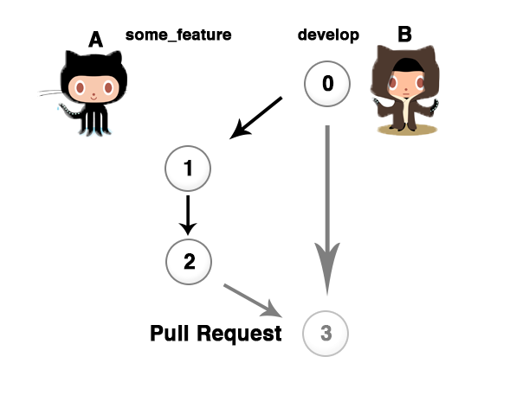
Git Pull Request
In their simplest form, pull requests are a mechanism for a developer to notify team members that they have completed a feature. Once their feature branch is ready, the developer files a pull request via their github account. This lets everybody involved know that they need to review the code and merge it into the master branch.

Slide 28
Git Pull Request: Workflow
The general process of Git Pull Request is as follows:
A developer creates the feature in a dedicated branch in their local repo.
The developer pushes the branch to a public github repository.
The developer files a pull request via github UI.
The rest of the team reviews the code, discusses it, and alters it.
The project maintainer merges the feature into the official repository and closes the pull request.
Master Branch
Feature Branch

Slide 29
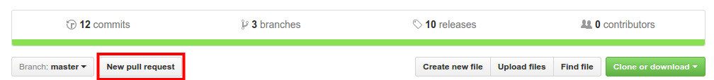
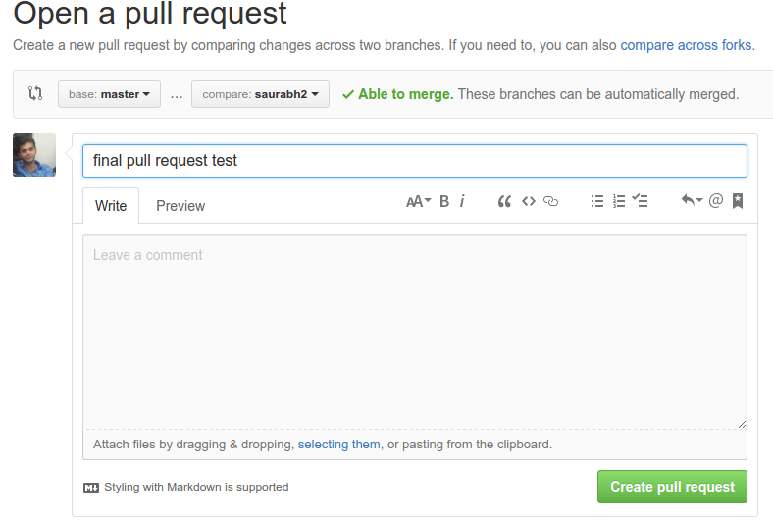
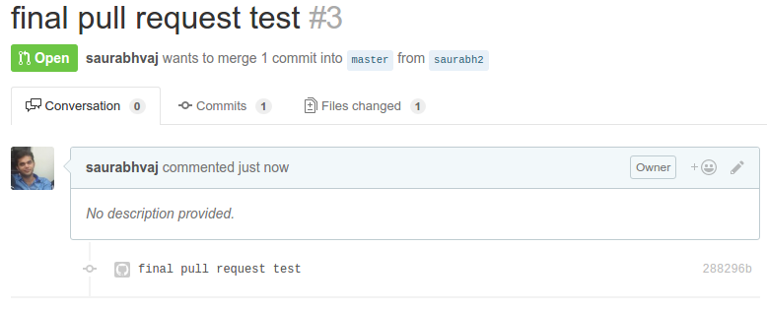
Git Pull Request

Slide 30

Hands on using Git 1/2
$ git init
Initialize a directory as git repo and tell git that where to track files.
Or
$ git clone
Make a copy of remote git repository into your local system.
$ git add .
Add all your changes (files and folders) to staging area for commit.
$ git status
Get information about untracked files and files added to commit.
$ git diff
Review the changes of your files.

Slide 31

Hands on using Git 2/2
$ git commit -m <your message>
Commit your changes from staging area to local repo. -m is compulsory.
$ git branch
List all available local branches and current branch.
$ git branch <branch name>
Create a branch.
$ git checkout <branch name>
Switch into another branch.
$ git log
Take a view on your all commits. All commits have a unique id.
$ git push
Send your changes to remote for better access.

Slide 32
Advanced Topics
Branching Strategies
Internals of Git
Multi Modular Projects
Remote repositories
Administration
Code Review
….

Slide 33

Questions ?

